Slide 1
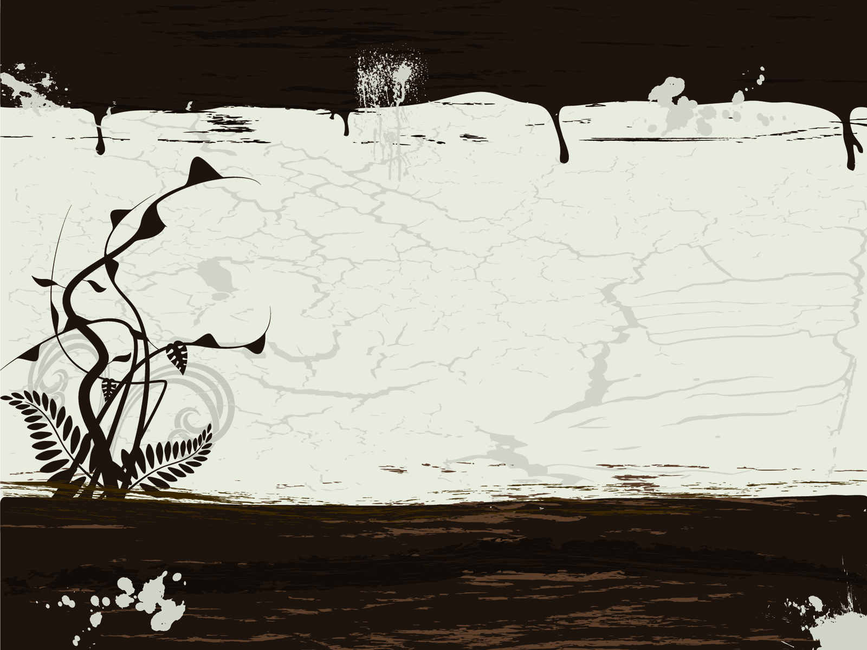
THE NOVEL (18TH CENTURY)

Slide 2
THE NOVEL
saw the flowering of novel.
Some trace this form of fiction back to Lyly’s Euphues and some term are from Bunyan’s Pilgrim’s Progress a novel.
ENGLISH NOVEL, have had its real beginning in the works of five men whose career overlapped: DEFOE, RICHARDSON, FIELDING, STERNE and SMOLLET.

Slide 3
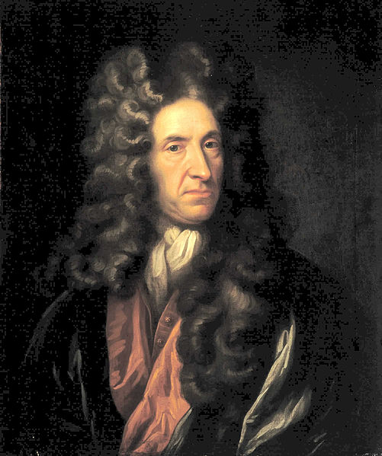
DANIEL DEFOE (1660-1731)
led an active life as a journalist and political pamphleteer.
More than once his opinions carried him into prisons.
He wrote many books, including the novels MOLL FLANDERS (1724).
His JOURNAL OF THE PLAGUE YEAR (1722) is written as a factual firsthand account of England’s great plague of 1664-65.
Its first and greatest novel appeared in 1719.
ROBINSON CRUSOE, a famous tale of shipwreck and solitary survival.

Slide 4
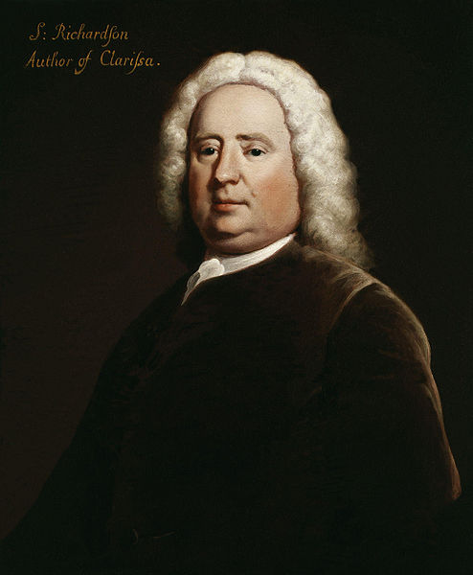
SAMUEL RICHARDSON (1689-1761)
A printer by trade, wrote the novel PAMELA: or, VIRTUE REWARDED (1740-42).
A story with a moral, it is told through letters written by its heroine– a device often used in early fiction.
Novels made up of letters are called EPISTOLARY NOVELS.
Two later Richardson Novels, CLARISSA (1747-48) and SIR CHARLES GRANDISON (1753-54), are also in the epistolary form.

Slide 5
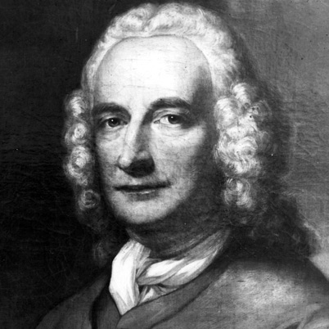
HENRY FIELDING (1707-54)
A successful dramatist.
Licensing Act of 1737 caused his plays to be banned.
JOSEPH ANDREWS (1742), a satire on the plot and sentiment of PAMELA and also owes a debt to the Spanish classic of the previous century, DON QUIXOTE.
His masterpiece is TOM JONES (1749), a memorable work rich in humor and social satire.
PICANESQUE NOVEL, a type of novel in which the story relates the wanderings and adventures of a picaro (spanisf for “rogue”).

Slide 6
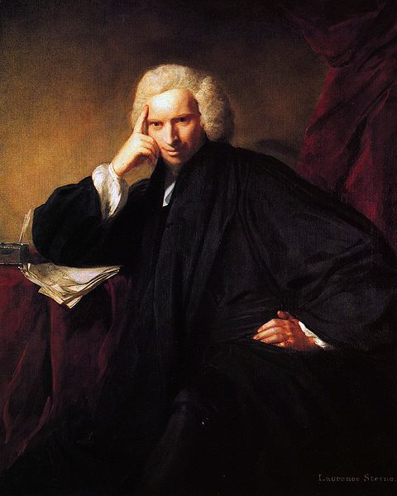
LAURENCE STERNE (1713-68)
A decidedly world priest of the church of England.
A by-product of his fondness for travel is his Sentimental Journey (1768).
His place as novelist rests on TRISTAMS SHANDY (1759-67), a work that shocked many and was both notorious and popular.

Slide 7
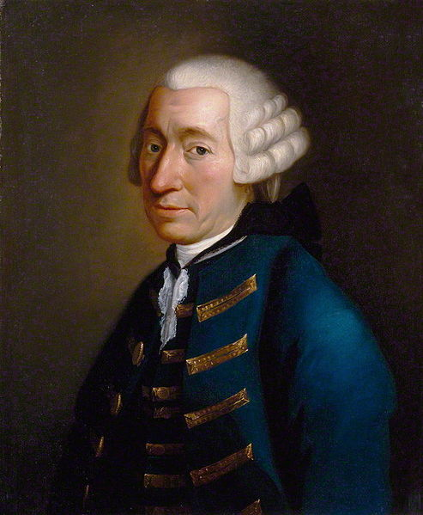
TOBIAS SMOLLETT (1721-71)
A Scot, worked as a Surgeon both in the Navy and in London.
His chief novels are RODERICK RANDOM (1748), PEREGRINE PICKLE (1751) and HUMPHRY CLINKER.

Slide 8
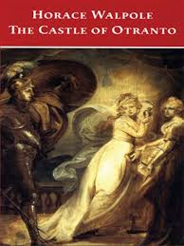
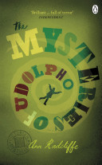
THE NOVELS (18TH CENTURY)…
A new form of novel emerged.
GOTHIC NOVELS, tales of Horror and the Supernatural.
HORACE WALPOLE (1717-97), wrote one of the earliest-- THE CASTLE OF OTRANTO(1764).
In 1794, the best of Gothic novels appeared, THE MYSTERIES OF UDOLPHO by ANN RADCLIFFE (1764-1823).

Slide 9
THE ROMANTIC PERIOD

Slide 10
THE ROMANTIC PERIOD
The first third of the 19th century makes up English Literature’s romantic period.
This era was unsettled one for England.
War with France begun in 1793 and continued until 1815.
Industrial Revolution, changing England from a rural society to a nation of factories.
Romantic writers broke with the 18th century belief in the power of reason; instead they place their faith in the imagination and the emotions.

Slide 11
POETRY
The chief form of expression for the romantic movement was poetry.
18th century poets had shown signs of romanticism.
WILLIAM BLAKE, one of the earliest romantic writers.
In 1798, two poets published a volume of poems that has been called romantic poetry’s “declaration of independence”.

Slide 12
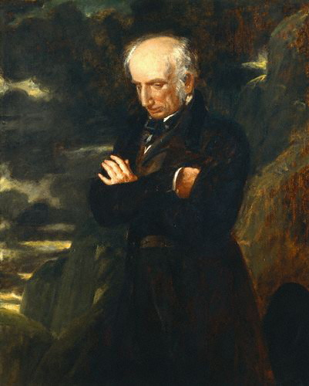
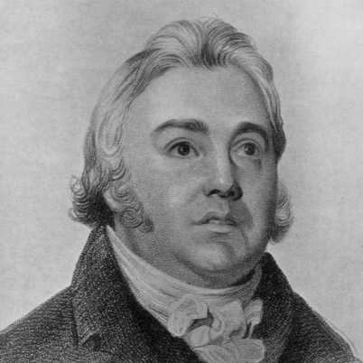
WORDSWORTH AND COLERIDGE

Slide 13
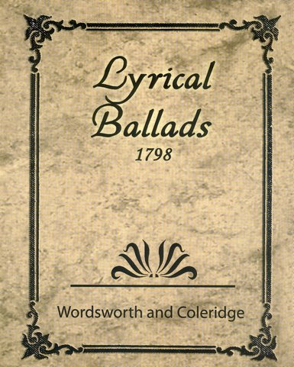
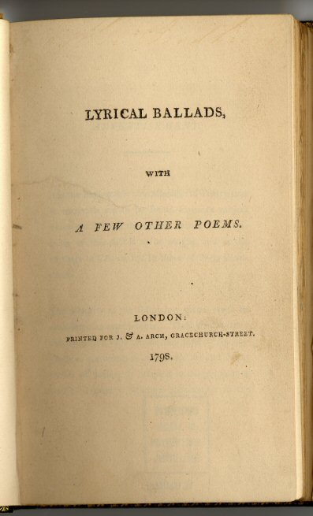
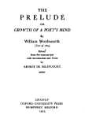
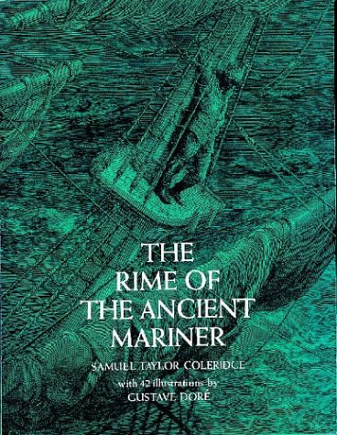
WORDSWORTH AND COLERIDGE …
Authors of Lyrical Ballads.
Collection of poems have many characteristics typical of romantic poetry.
Distinguished for writings on criticism and principles of poetry.

Slide 14
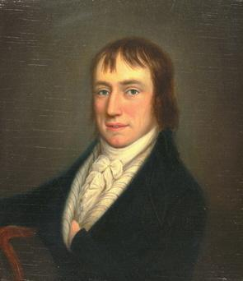
WILLIAM WORDSWORTH (1770-1850)
Wordsworth verses, are about country scenes and country people and show his love for nature.
The famous “LINES COMPOSED A FEW MILES ABOVE TINTERN ABBEY” appeared in Lyrical ballads.
Representative of Wordsworth’s other work is the long autobiographical poem, THE PRELUDE, which was NOT published until 1850, and such shorter poems as “MY HEART LEAPS UP WHEN I BEHOLD” and “I WANDERED LONELY AS A CLOUD”, also called “DAFFODILS”.
Wordsworth’s poetry varies widely; some is written in plain language, and other poems style is complex.

Slide 15
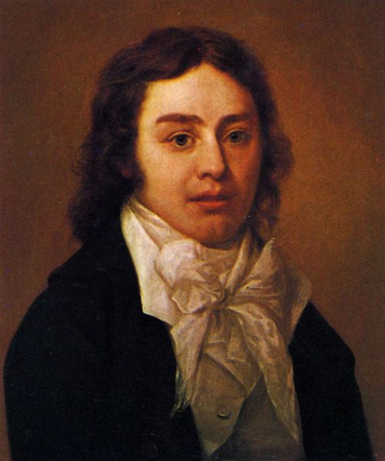
SAMUEL TAYLOR COLERIDGE (1772-1834)
Coleridge’s major work of this sort is the autobiographical BIOGRAPHIA LITERARIA (1817).
MOST FAMOUS POEMS: “THE RIME OF THE ANCIENT MARINER”, appeared in Lyrical ballads.
He is also well known for the unfinished “KUBLA KHAN” and “CHRISTABEL”.

Slide 16
ENGLISH-AMERICAN LITERATURE
REPORTED BY: BELLEN, ALYSSA C.
BSED-ENGLISH 2

