Slide 1
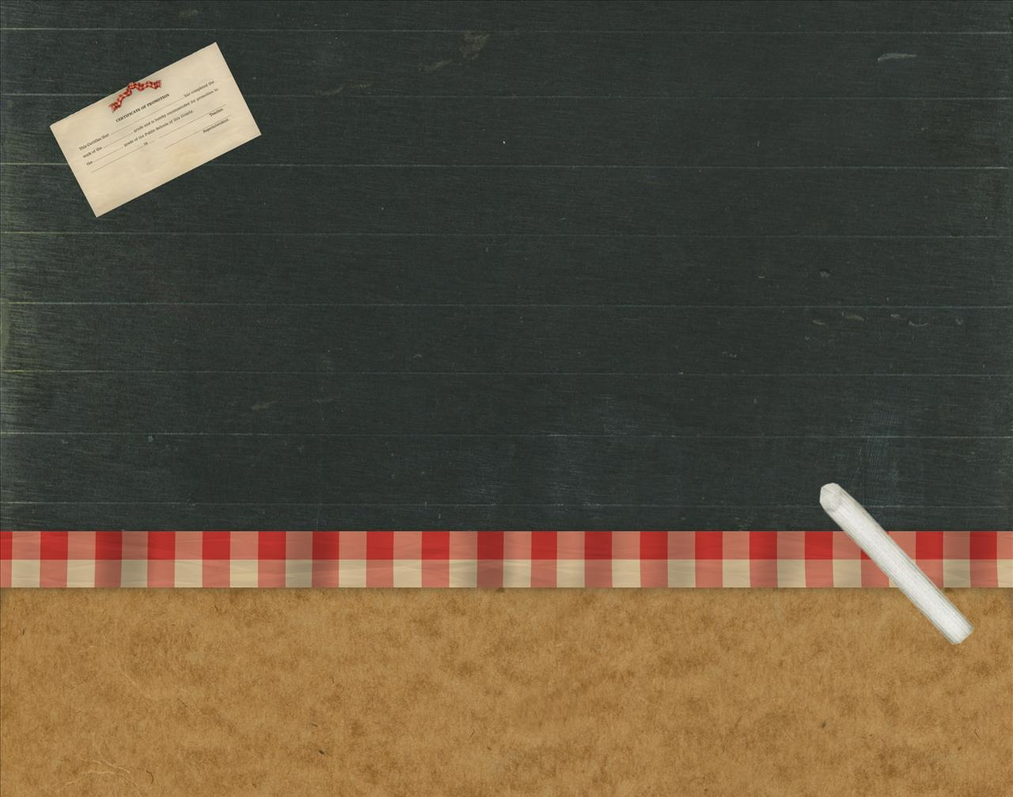
MIDDLE ENGLISH DRAMA

Slide 2
MIDDLE ENGLISH DRAMA
RELIGIOUS DRAMA – important part of Middle English Literature.
NOT created for reading
ORIGINS OF DRAMA:
bound up with worship
few could read
Christian Story And Lessons of The Bible brought to people by Simple Dramatic Scenes.
GUILDS, a group of merchants and laborers who performed on certain biblical stories. ( PLASTERERS, SHIPWRIGHTS, GOLDSMITHS)
MIRACLE PLAYS, dramas based on saints’ and biblical miracles.

Slide 3
It became an annual event in England and Europe.
48 dramas, cover the whole biblical history from York.
SECOND SHEPHERDS’ PLAY, most widely read of all ; a drama about the Nativity from the town of Wakefield.
MORALITY, another type of play ; a form of allegory.
EVERYMAN, the greatest allegorical morality play in 15thcentury ; shows the summoning of Everyman by Death.

Slide 4
EARLY 16TH CENTURY

Slide 5
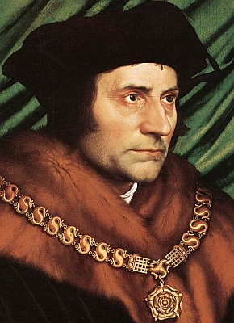
SIR THOMAS MORE (1478-1535)
wrote a remarkable book, UTOPIA (1516). Its title comes from the Greek word meaning “NOWHERE”.
It tells of a journey to an imaginary island named Utopia, where an ideal form of society exists.
More’s book has a placed a word in our vocabularies and given name to all literature of this kind, which has been called Utopian.

Slide 6
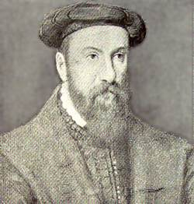
ROGER ASCHAM (1515-68)
Known for his principal work, THE SCHOOLMASTER.
published after his death.
It is a criticism of educational method.

Slide 7
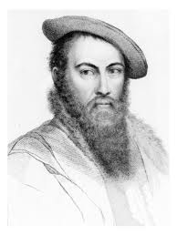
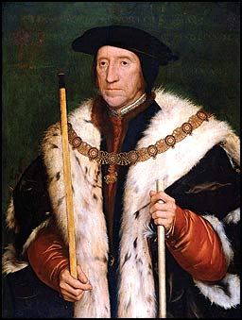
SIR THOMAS WYATT (1503-42) ;
EARL OF SURREY (1517-47)
established the SONNET.
SONNET, a 14-line poem, as an English verse form.
Adopted from Italian tradition.
became a major form in all English poetry that followed.

Slide 8
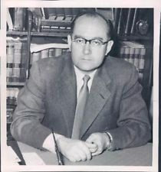
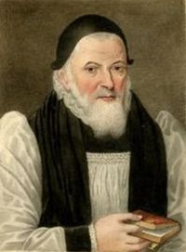
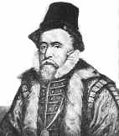
FARCES – two of the best early nonchurch, or secular ; a funny plays filled with ridiculous happenings.
NICHOLAS UDALL (1505-56)
wrote RALPH ROISTER DOISTER (1533?)
JOHN STILL (1543-1608)
wrote Gammer Gurton’s Needle (1566?)
THOMAS NORTON(1532-84) ; THOMAS SACKVILLE(1536-1608)
wrote the Tragedy of Gorboduc (1562).

Slide 9
THE ELIZABETAHN AGE

Slide 10
THE ELIZABETHAN AGE
Elizabeth I reigned from 1558 – 1603.
England experienced a burst of literary brillance that began slowly and reached a peak with the achievement of William Shakespeare.

Slide 11
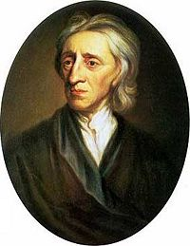
JOHN lyLY (1554? – 1606)
he write a number of plays, but he is known for his work, Eupheus: The AnatomyOf Wit (1578)
it has been called the first English novel, but its form differs reatly from that later novels.
There was a sequel in 1580, Eupheus and his England.
His work launched a fashion for an ornate, flower style of writing.
The style came to be known as Euphuism.

Slide 12
ENGLISH-AMERICAN LITERATURE
REPORTED BY: BELLEN, ALYSSA C.
BSED-ENGLISH 2

